Slide 2
The Power of Your Dictionary
Basic realtime writing will get you EVERYWHERE
Know your dictionary
What’s in your head has to reconcile with your dictionary
Good/new changes are not effective if you don’t work on both
RT notebook. Write it down. Check off after you have reconciled as much as you know how.

Slide 3
“I can’t write good realtime if they don’t give me a good word list.”
“Dictionary 101”
Your main dictionary and your writing style combined give you FAR more results in your realtime writing than a job-specific list EVER will.

Slide 4
The Power of Your Dictionary
Make sure that fine-tuned dictionary and your brain are always on the same playing field.

Slide 5
We have some wonderful gurus in our profession!
They can teach you MANY great tips and even their entire curriculum
______________________
So what’s stopping you from choosing a guru
to follow and implementing what they do
across the board?

Slide 6
Creating your own Curriculum
If you’re going to be effective in advancing, you first need to figure out:
How to learn
How to organize
How to recognize cans of worms or roads you don’t want to go down
How to take those methods you do want to expand upon and create patterns and ideas you can master in MANY different ways.

Slide 7
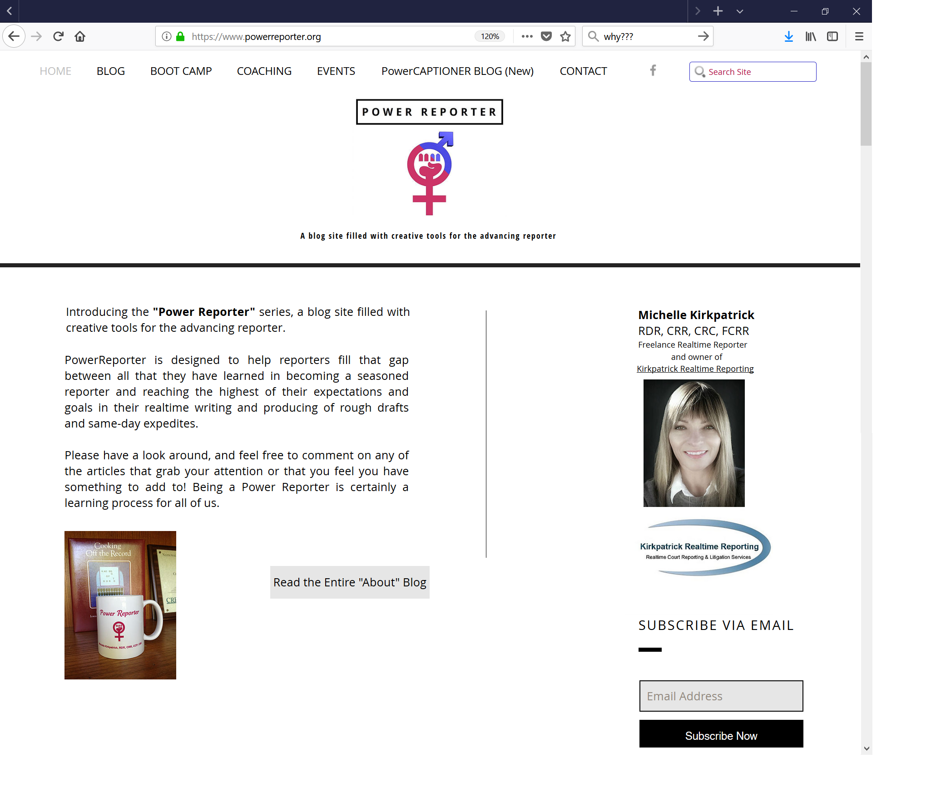
Notes:
http://PowerReporter.org

Slide 8
Notes:
Recommend reading blogs from the oldest to the newest.

Slide 20
Why clean up your dictionary and your writing style? HOW to clean up your dictionary and your writing style?

Slide 21
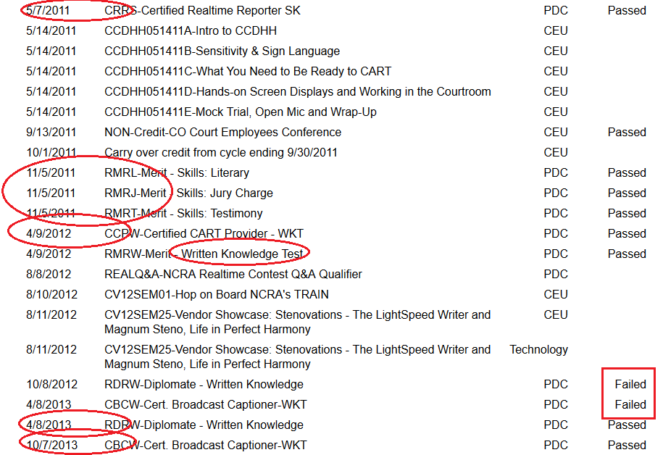
Notes:
Two and a half years to get my CRR, CRC, CBC, RMR, and RDR. (Also the FCRR in that time frame as well.) I now also have my CRCR (CO).

Slide 23
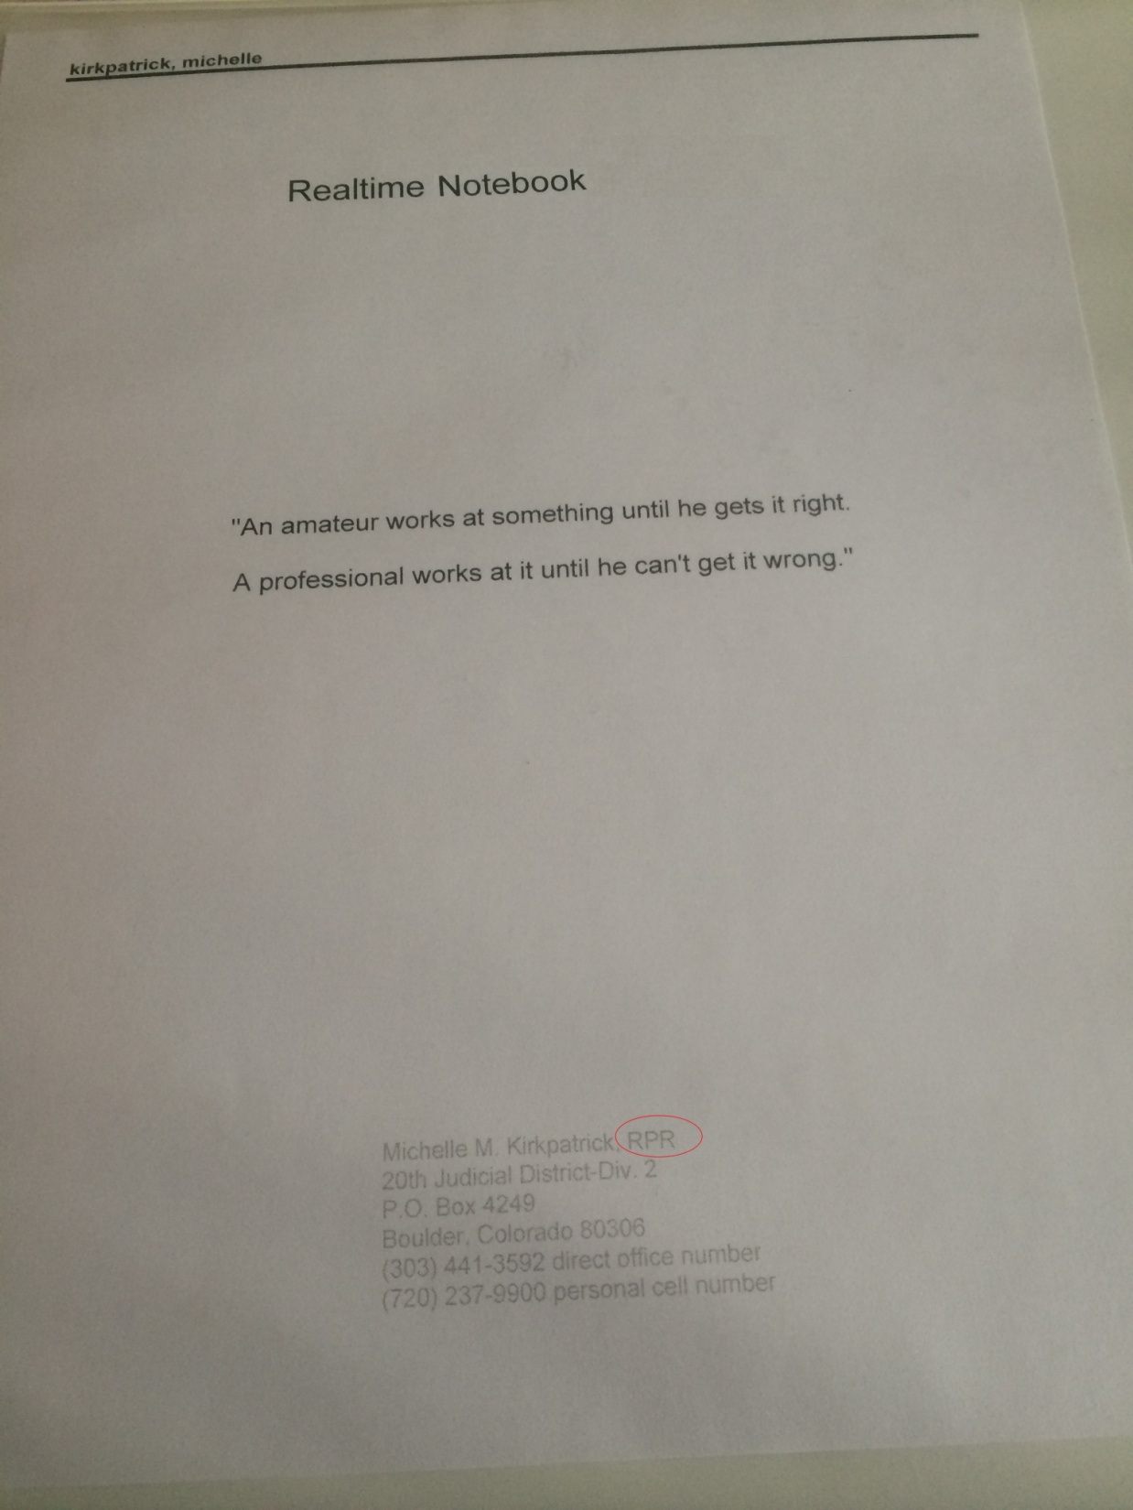
Notes:
My realtime notebook had its beginning when I was an RPR.

Slide 24
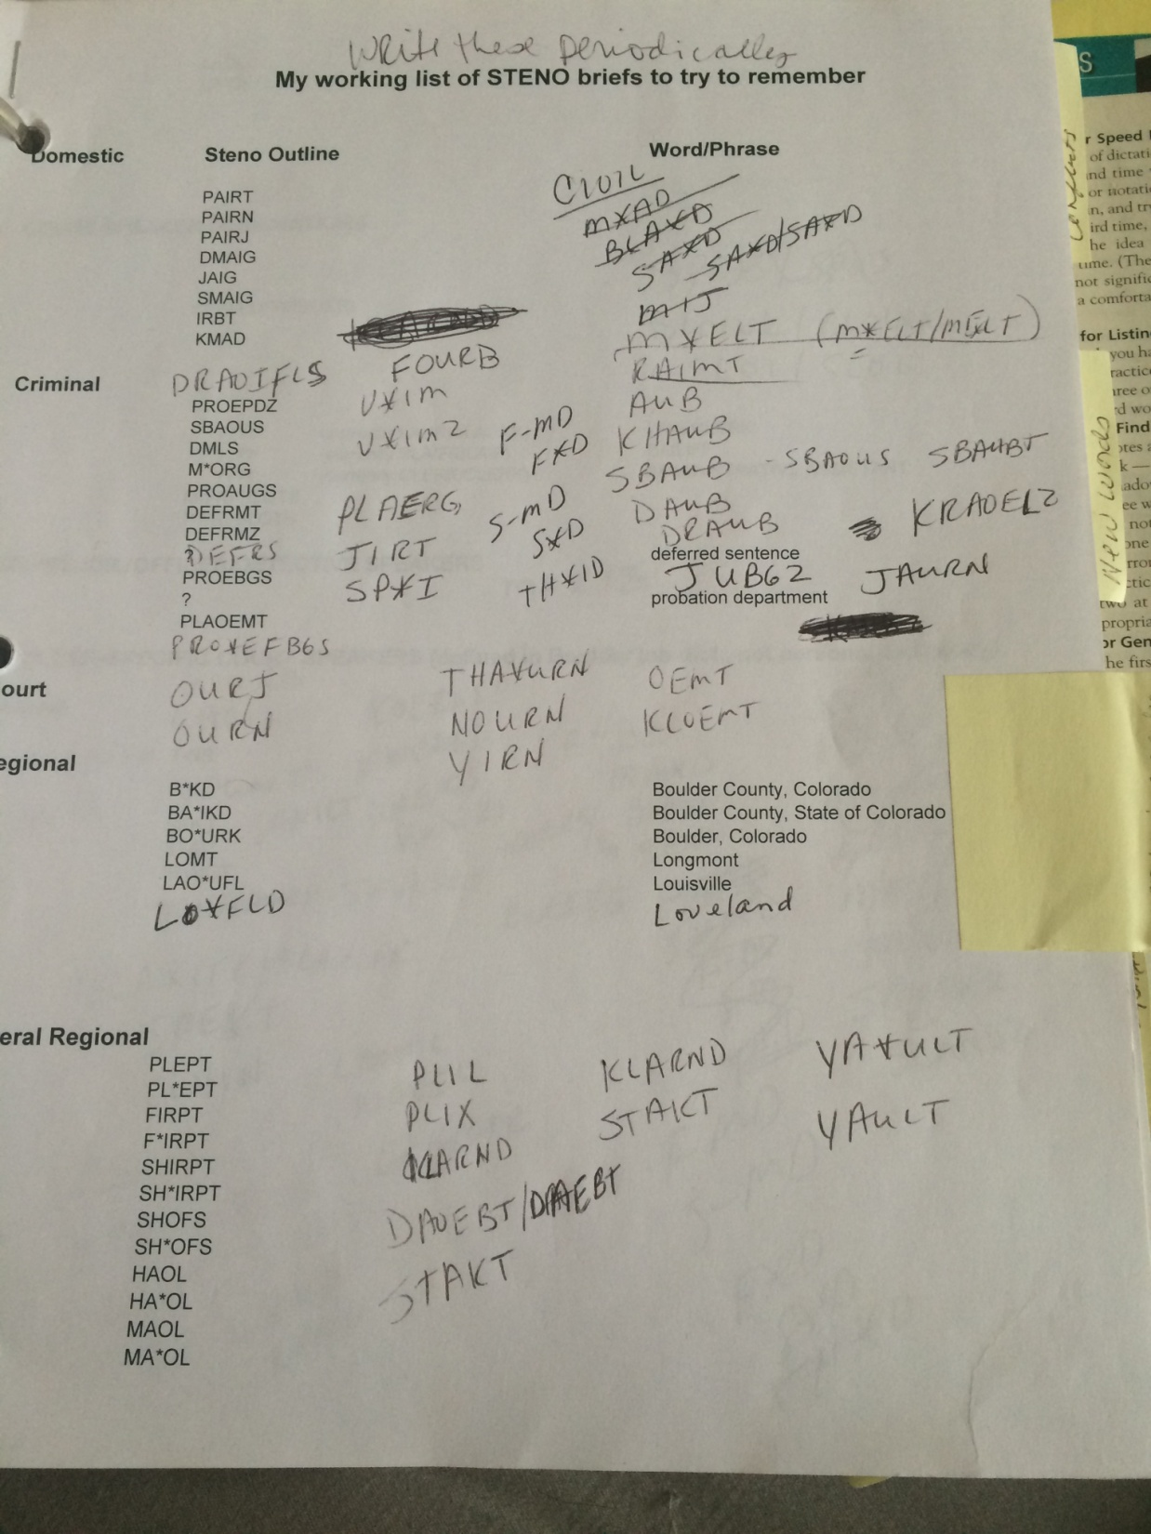
Notes:
Very humble beginnings. Extreme trial and error.

Slide 25
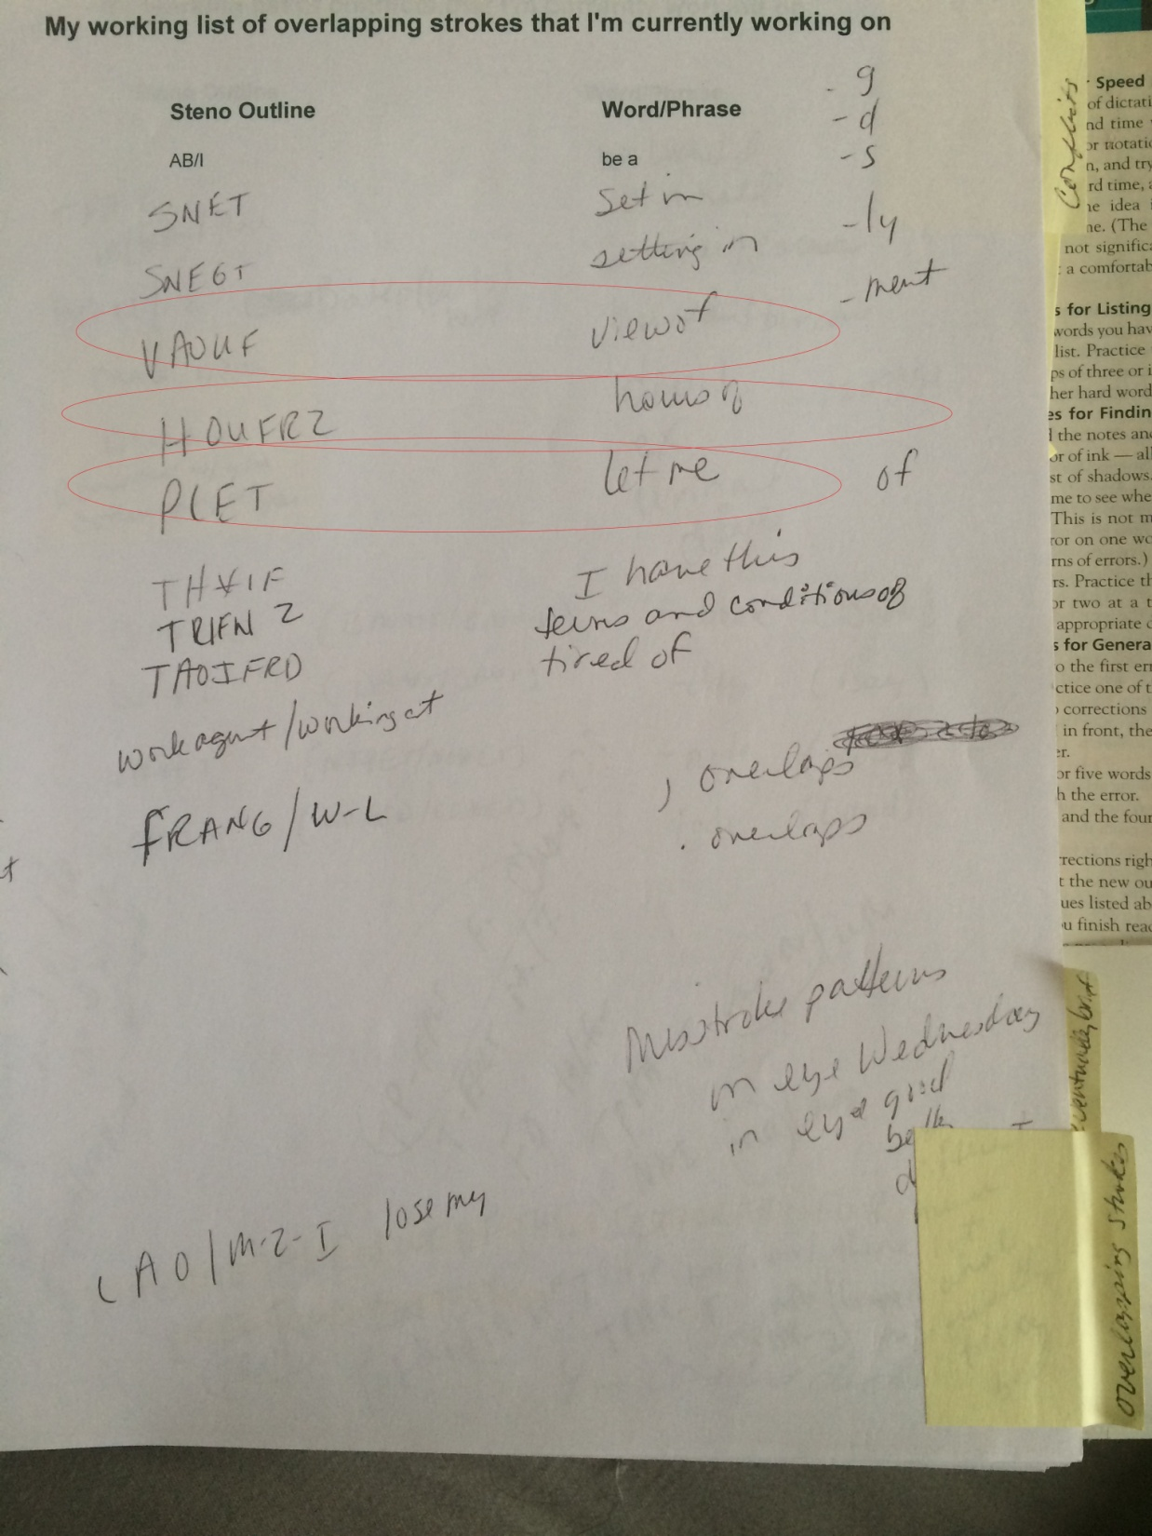
Notes:
The genesis of the “Realtime Notebook” concept.

Slide 26
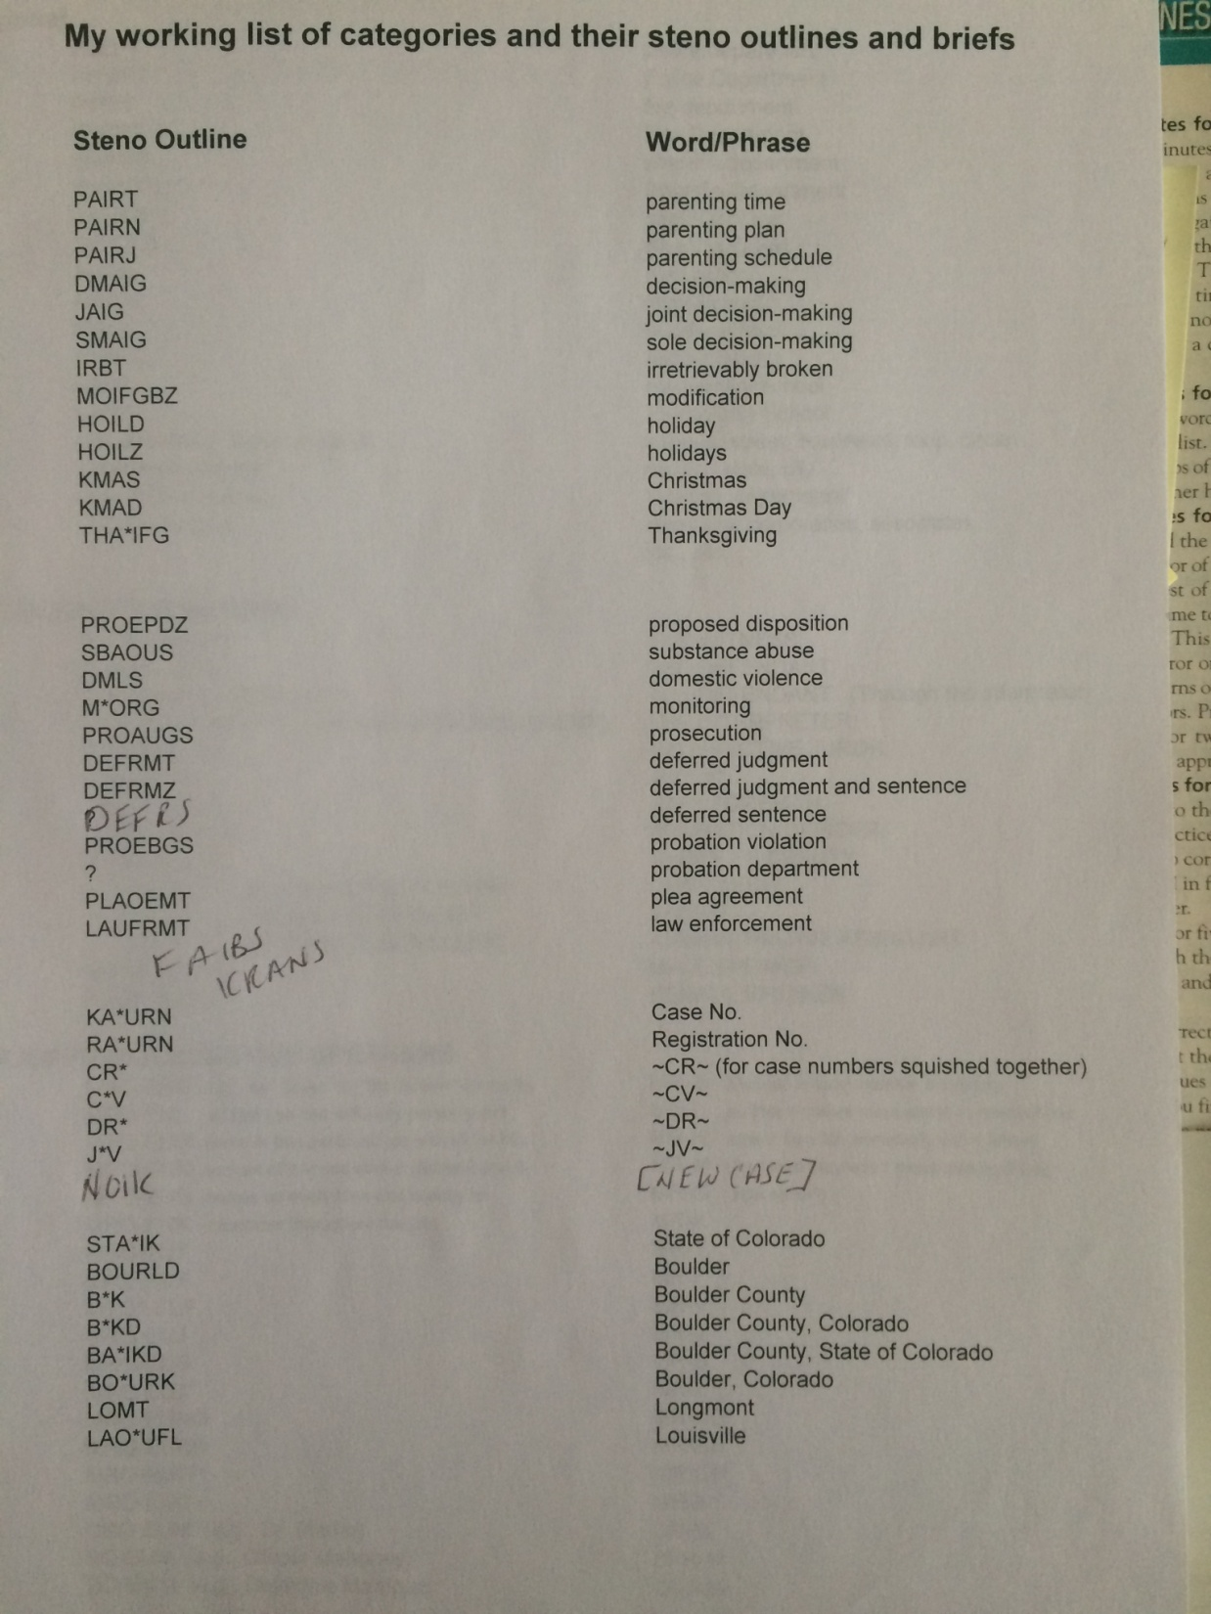
Notes:
I developed categories but still didn’t quite understand “families.”

Slide 27
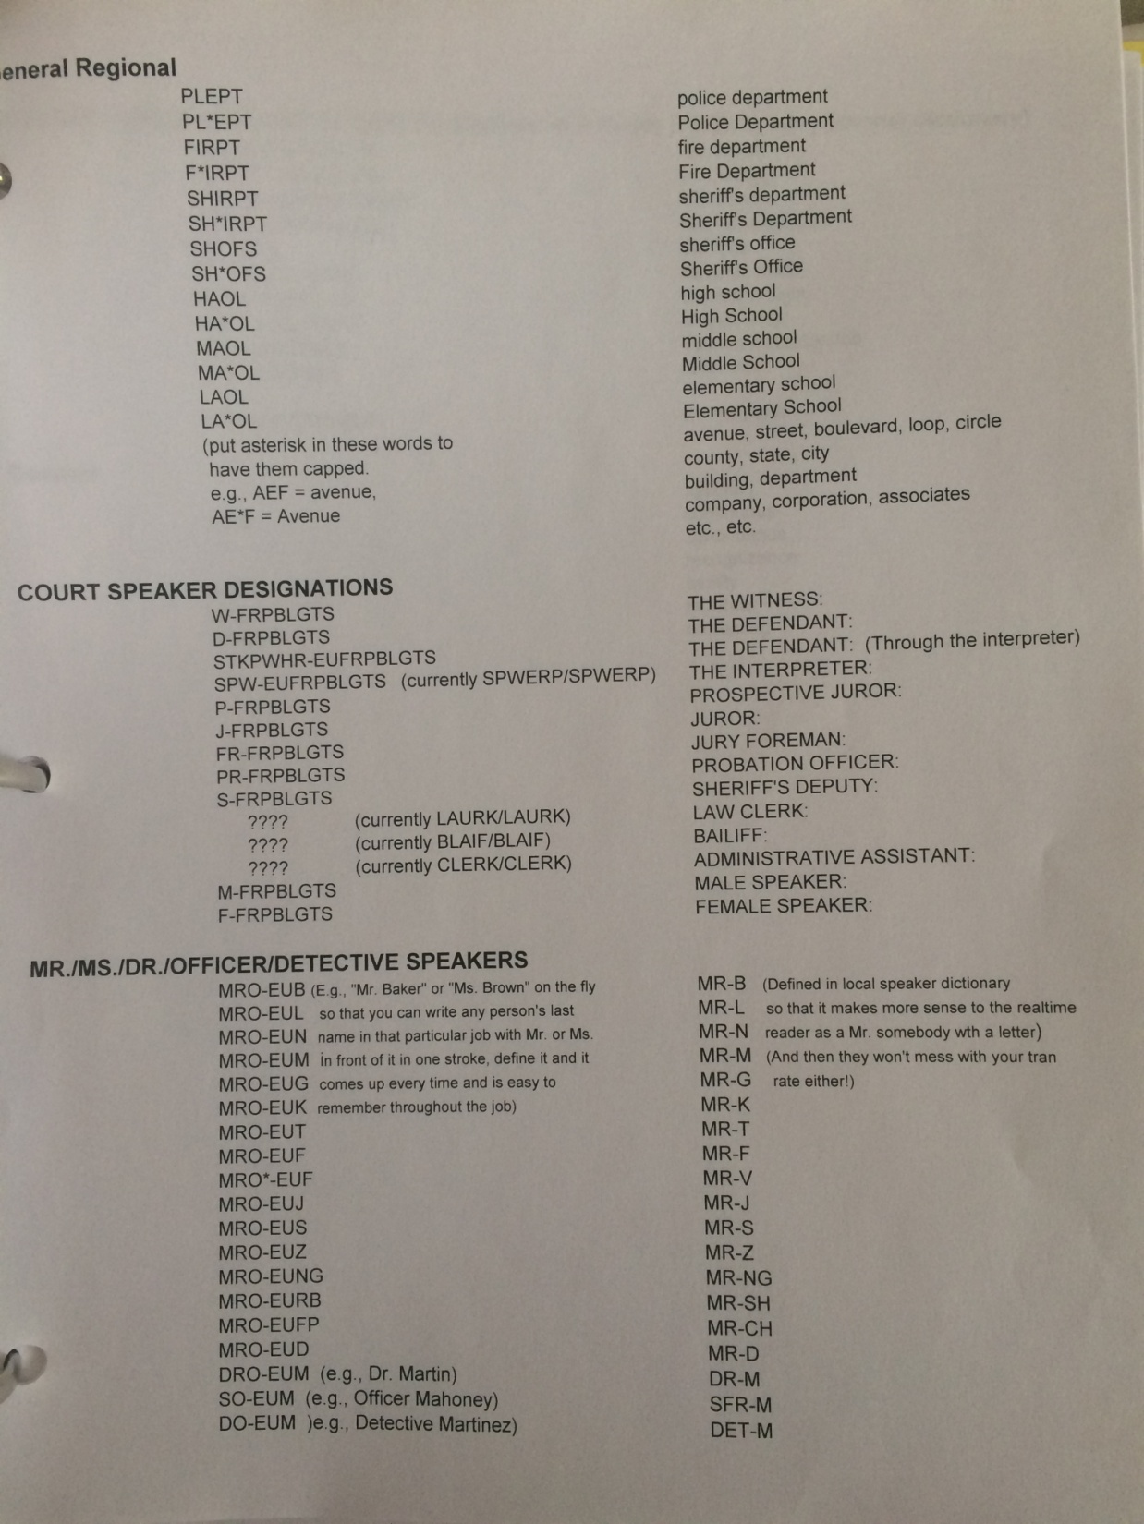
Notes:
Now we’re getting somewhere – family of briefs at the top and then speaker families

Slide 28
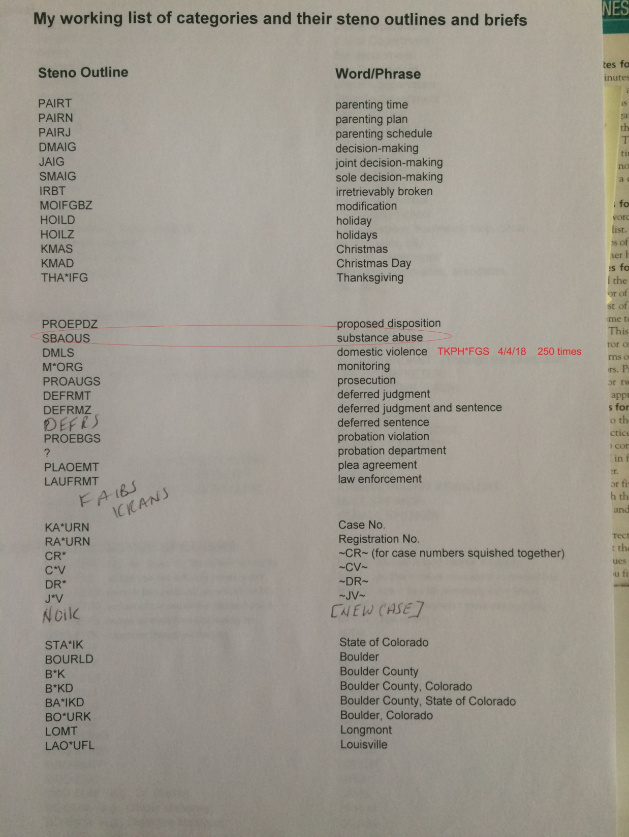
Notes:
The “category” was court phrases. But developing “substance abuse” was a shotgun approach. There was a whole “family” there I didn’t tap into.

Slide 29
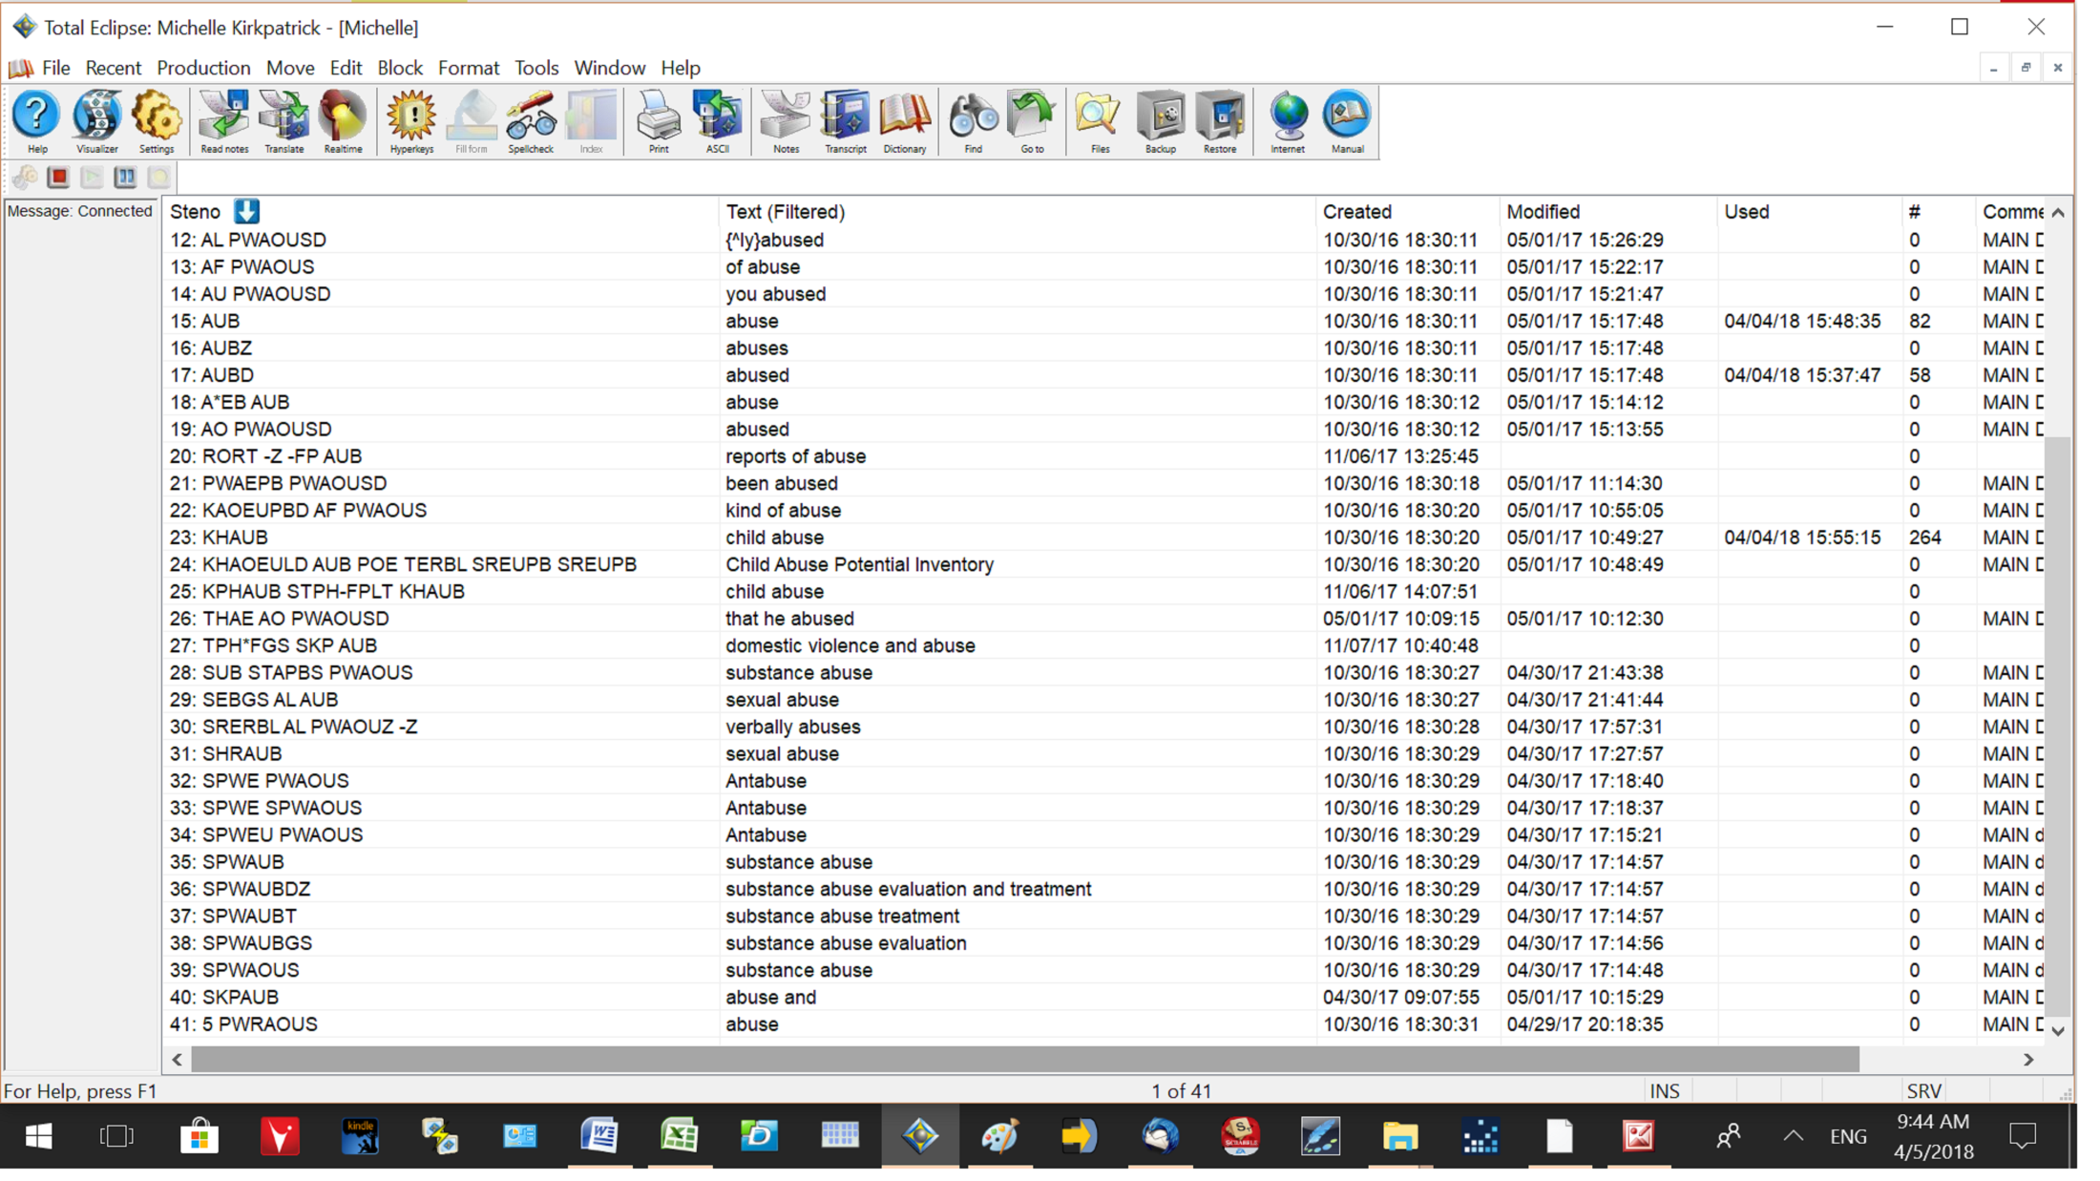
Notes:
“Abuse” as two words in my dictionary and then “abuse” written as AUB. then half a family created with this idea.

Slide 30
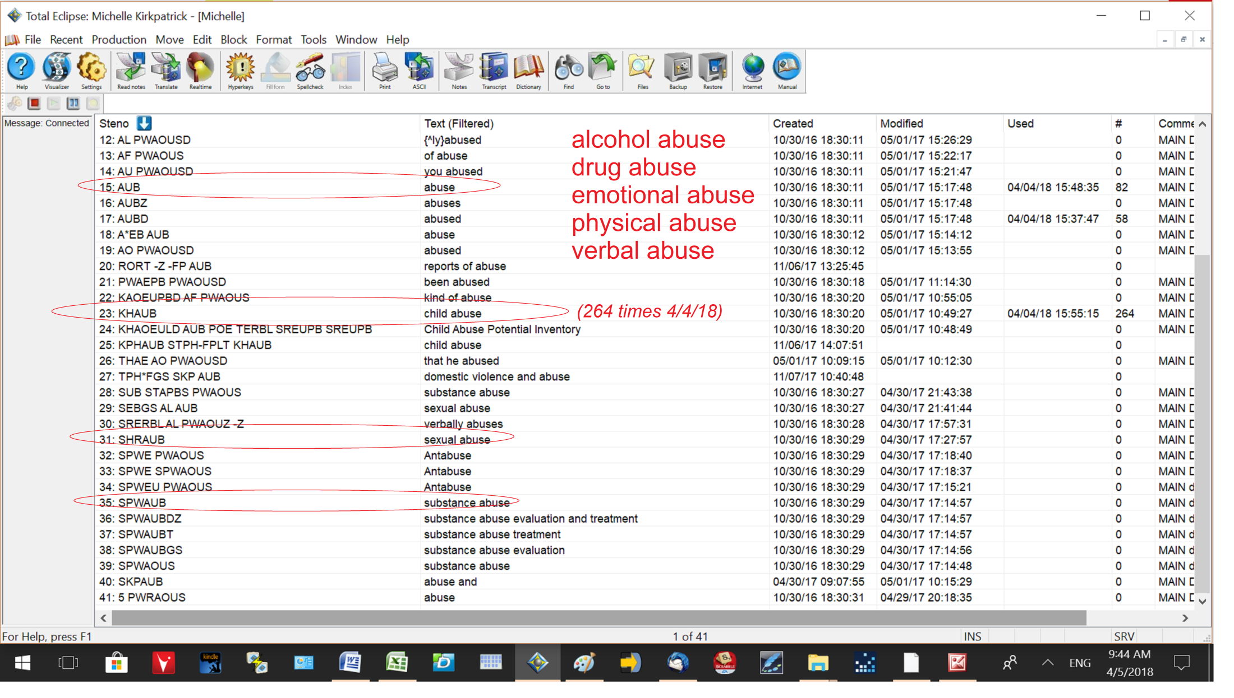
Notes:
I got lucky -- a “shotgun approach” saved me 264 times on the Tuesday before this screenshot (April of 2018).

Slide 32
Notes:
No shotgun approaches!

Slide 33
Notes:
This is what most people think of when they think of that road to success: It’s going to be a long journey, but it’s all laying right out there for me

Slide 34
Notes:
This is what we’re told that the path to success looks like, right?

Slide 35
Notes:
You simply emulate what you’ve seen and, voila, there you are.

Slide 36
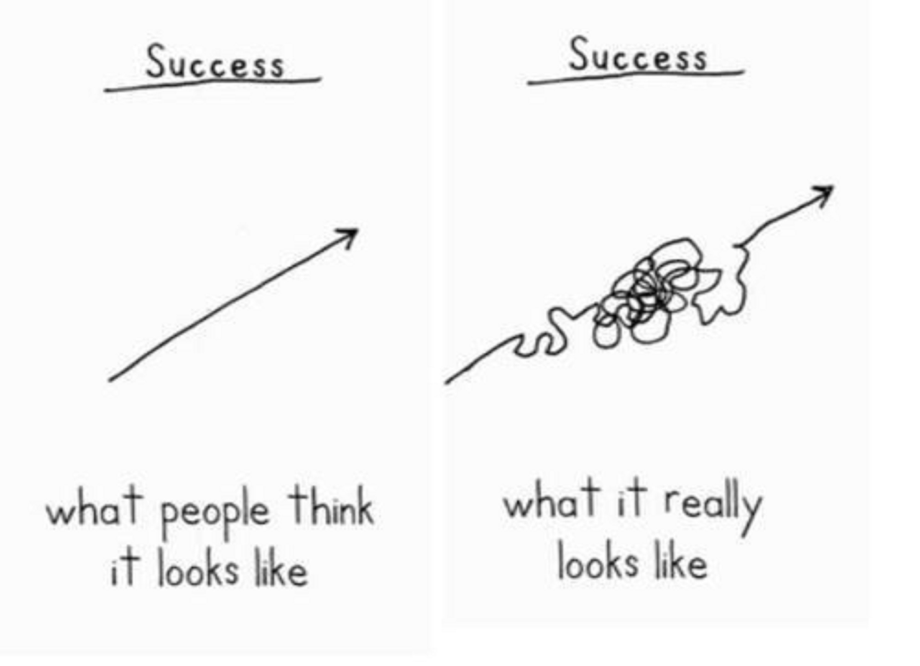
Notes:
Success is a *lot* of trial and error.

Slide 37
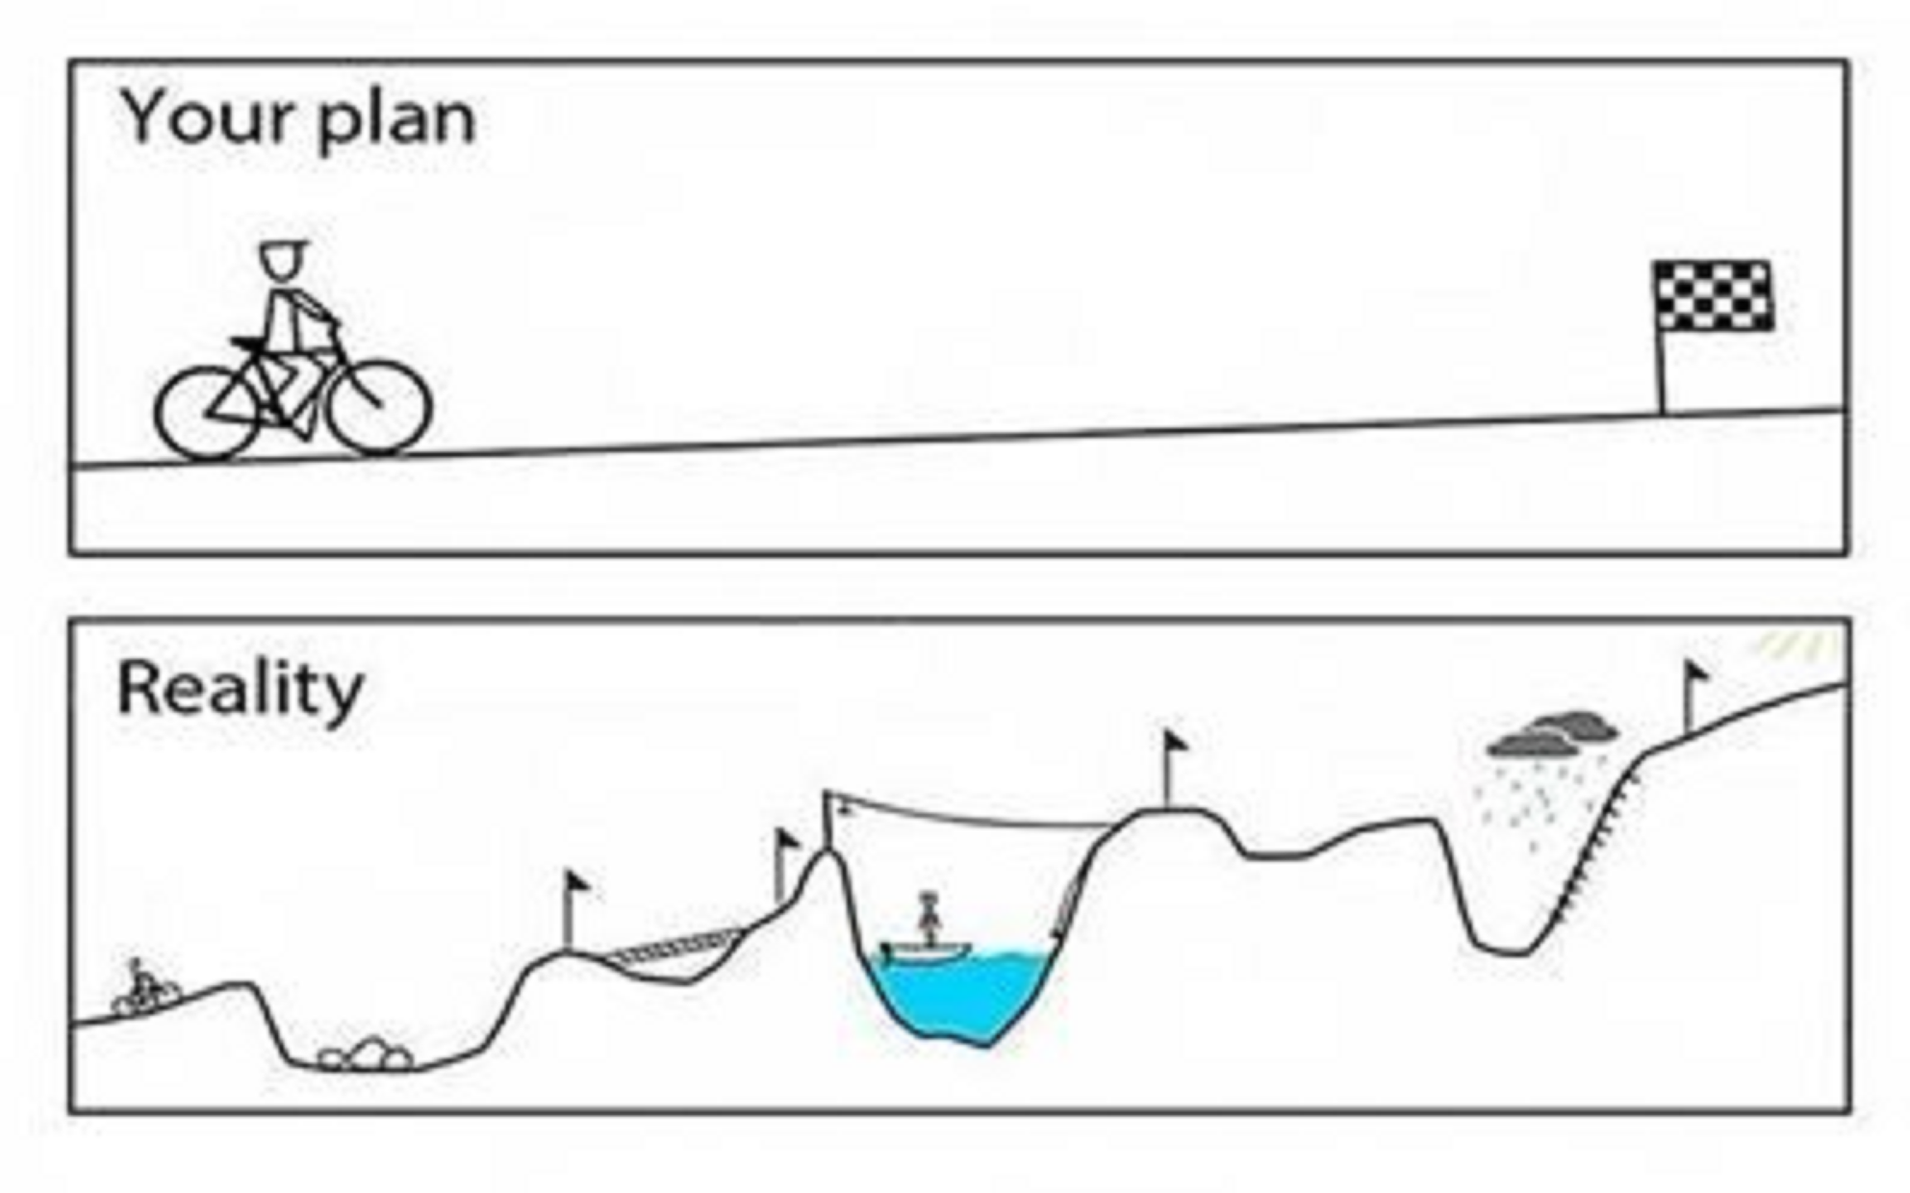
Notes:
Actually, for me, it’s looked a whole lot more like this.

Slide 39
Notes:
The road can be confusing, and sometimes we’re not even sure which road we’re even on anymore.

Slide 40
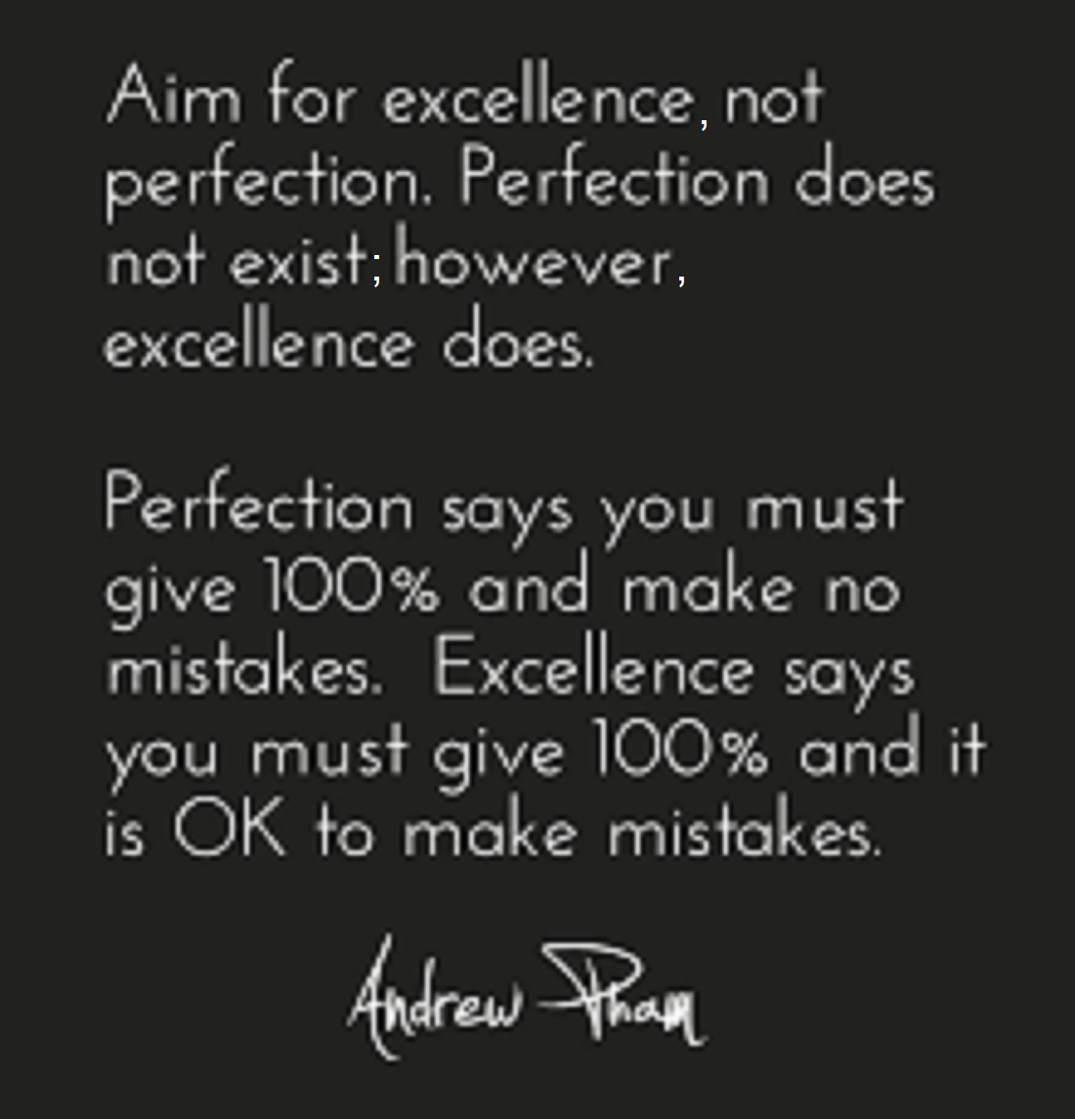
Notes:
Striving for excellence, not perfection – a huge and very important distinction!

Slide 41
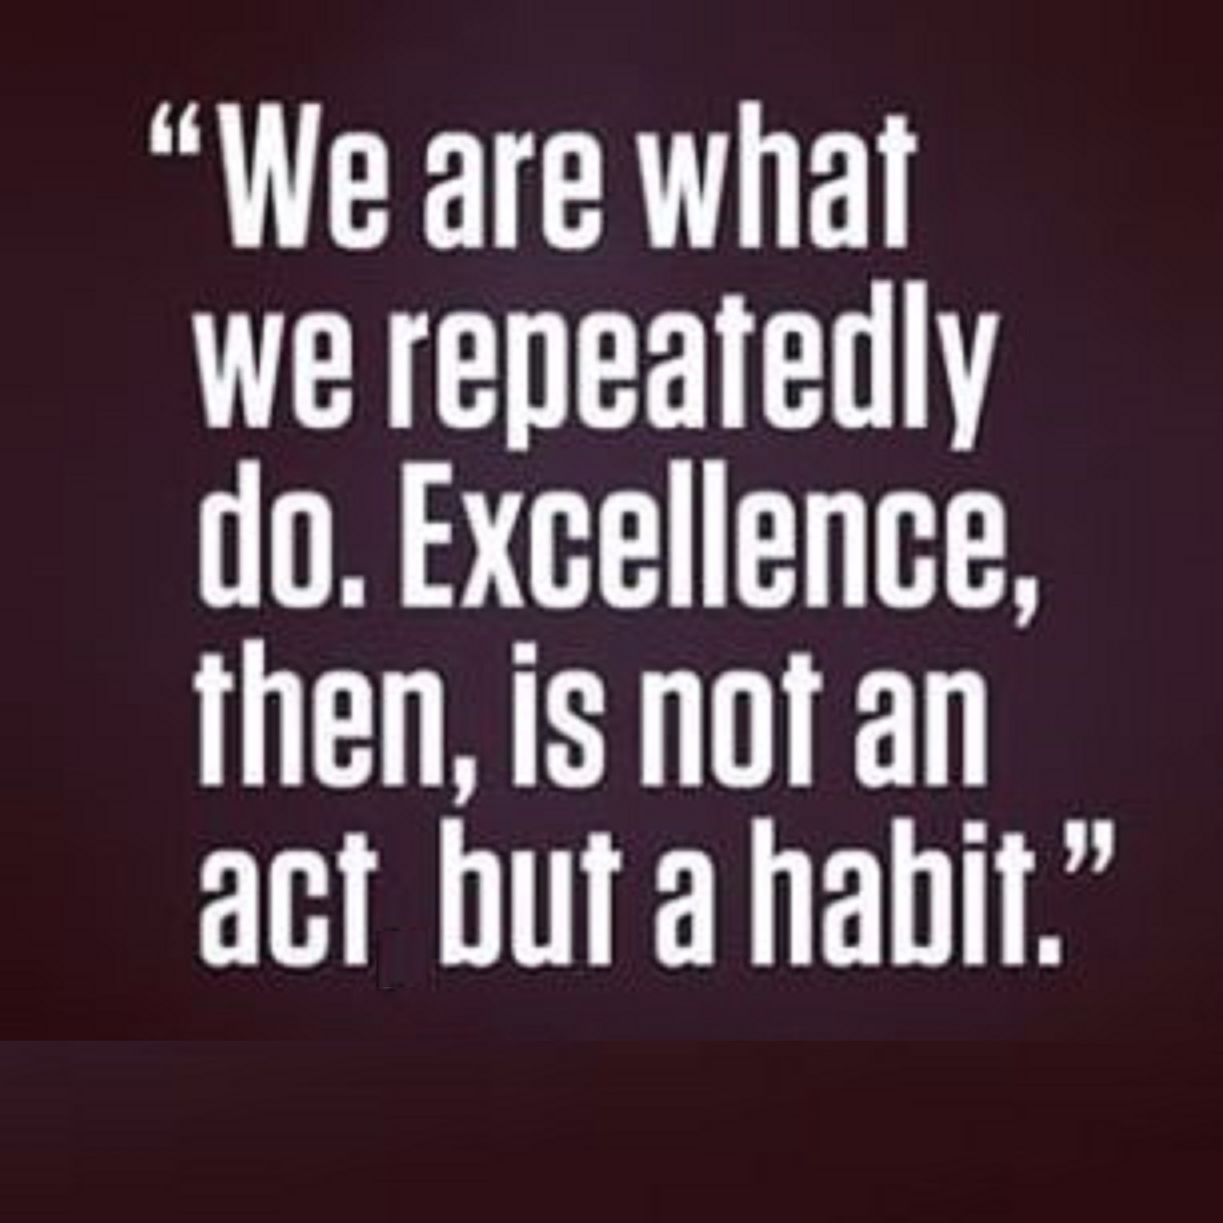

Slide 42
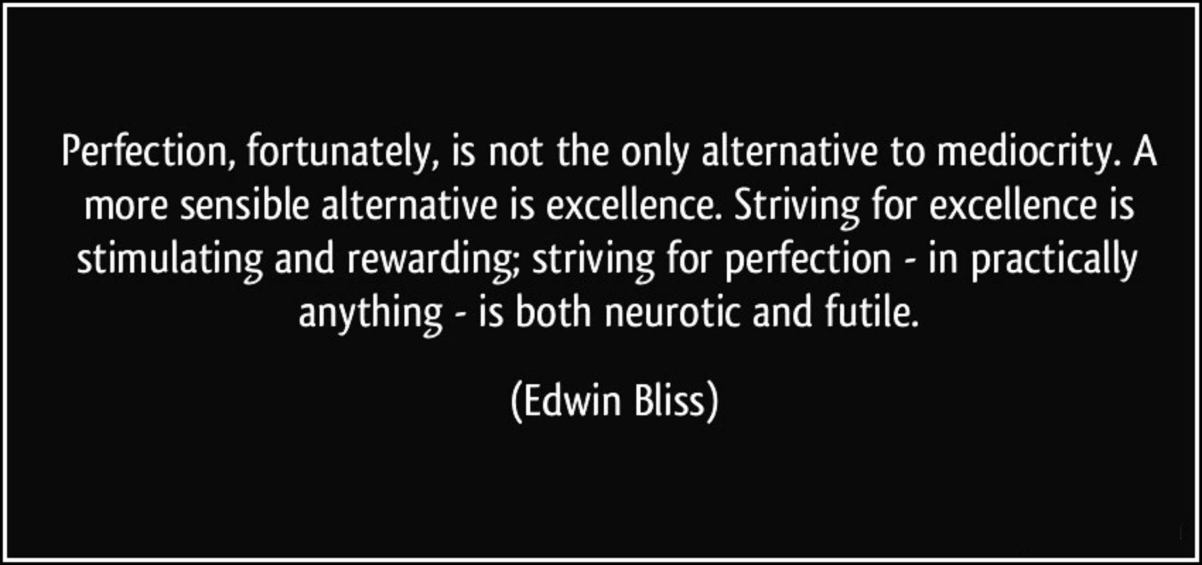

Slide 43
Cognitive Flexibility
Notes:
The Power of Building “Cognitive Flexibility”

Slide 44
At a Glance
Flexible thinking allows you to switch gears and look at things differently.
Flexible thinking requires the ability to “unlearn” old ways of doing things.
Flexible thinking plays a key role in all types of learning.

Slide 45
“Flexible Thinking” and “Set Shifting”

Slide 46
Investing in Yourself is Something You Get to Keep Forever

Slide 47
A solid plan is they key
Notes:
Remember that you’re not going to accomplish all of this at once. Build your notebook first!! Then figure out a plan.

Slide 49
Notes:
“The Art of Possibility” talks about considering how many different ways you can “think outside the box.”

Slide 50
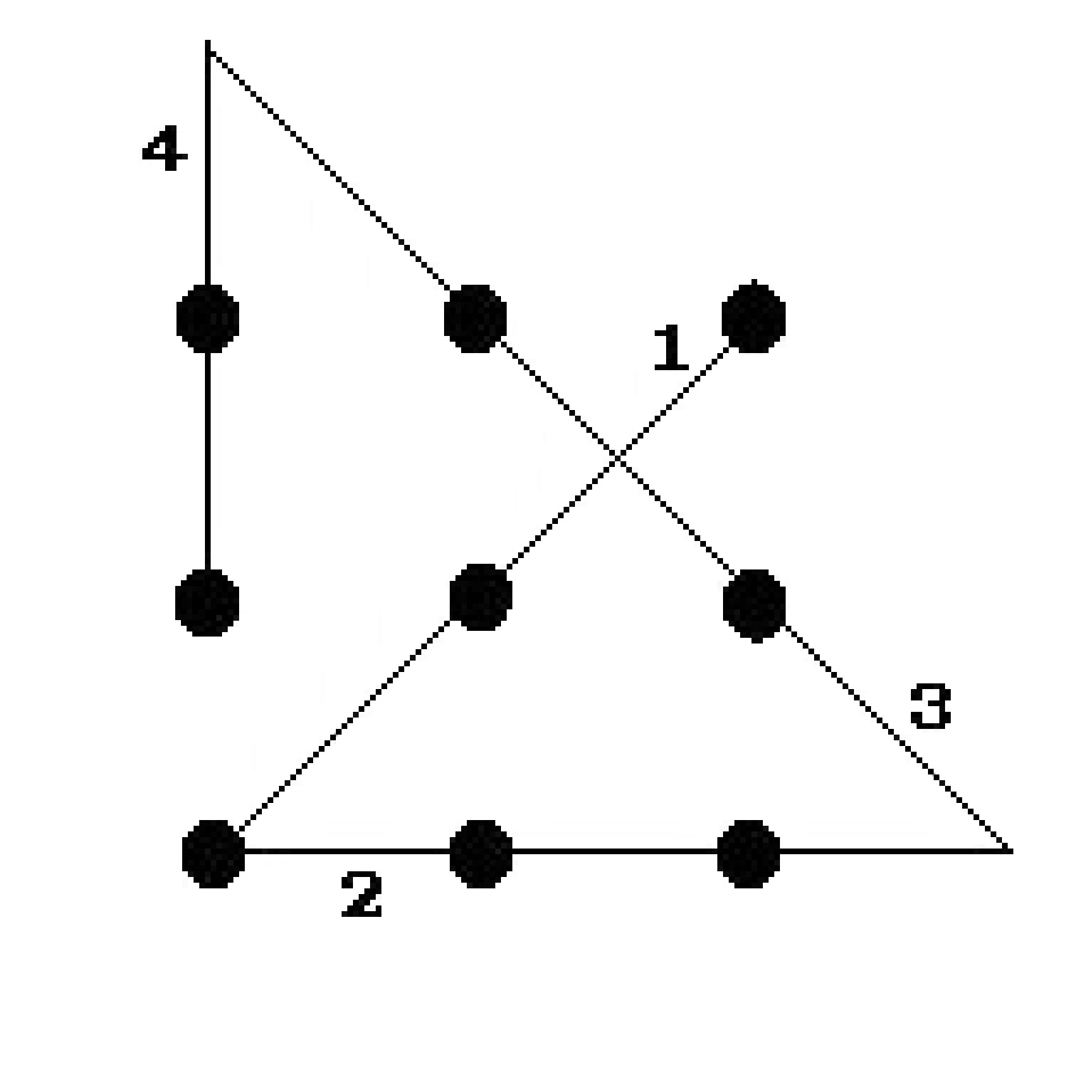
Notes:
If you were given nine dots and told to draw four lines without lifting your pencil, could you do it?

Slide 51
Notes:
Not only is there a way to accomplish this, there are actually multiple ways to accomplish this!

Slide 52
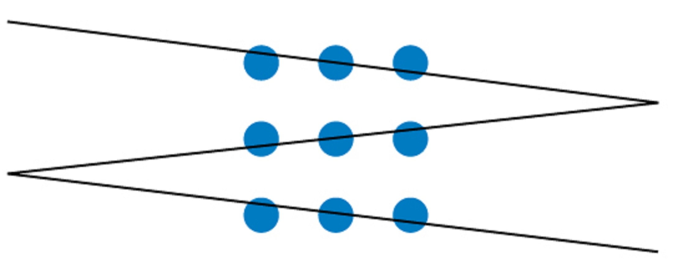
Notes:
In fact, you can even do it with THREE lines if you get really creative!

Slide 53
How many ways can we:
Use those little keys to make briefs?
There are infinitely more combinations than our little brains can think of
warrant – search warrant, bench warrant, arrest warrant
as soon as: SAOS, as soon as possible: SAOPS
it was: T-FS, was it: T*FS there was: THR-FS, was there: THR*FS
Right-hand phrase-enders (RHPE), left-hand phrase-beginners (HELP)
Mark K. has over 300 RHPEs https://ncra.org/Files/AnnualConvention/2013Convention/Sat_0730_RHPE_Kislingbury.pdf
How many *different* ways can we think of to create speaker IDs?
Let’s explore on the easel and see what we can come up with for different ways in just a minute or two. I am quite confident that we can come up with many *different* methods for creating them and actually identify a hundred speaker IDs in just minutes!
Notes:
Granted, that was a bit of an exercise in futility, but the point is, how many ways can we . . .

Slide 54
How many ways can we:
Use choices of writing styles to help us with our everyday writing?
My example: SR-RS = [repeat word or phrase]
THE COURT: These are just people to excuse, and they don't have to be alphabetized. This stack is going to need to get [repeat word or phrase].

Slide 55
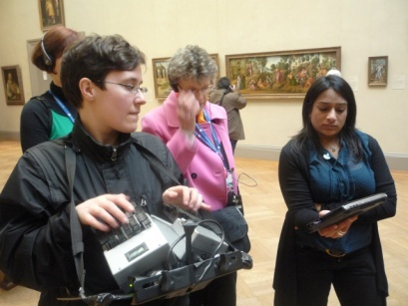
“The Plover Blog”
Consider this:
Mirabai Knight
I know some people advocate that students adopt experts' theories and briefs wholesale, because they think that otherwise beginners will tangle themselves up trying to devise their own briefs, but I completely disagree with that way of thinking. I'm hopeless at memorizing other people's briefs, but I can't live without the ones I've invented.
In my opinion, building one's own system piece by piece is the only way to get truly fast, efficient, and hesitation-free. I'm convinced that that's why Ed Varallo and Mark Kislingbury are so good: Not because they somehow both hit upon the One True Perfect Stenographic System (their theories are actually quite different from one another), but because they both built their own systems from the bottom up. They're intimately familiar with every outline in their respective dictionaries because each one sprang from their own brain and fingers.
http://plover.stenoknight.com/2010/06/steno-101-how-to-do-it.html
Notes:
”In my opinion, building one's own system piece by piece is the only way to get truly fast, efficient, and hesitation-free.”

Slide 56
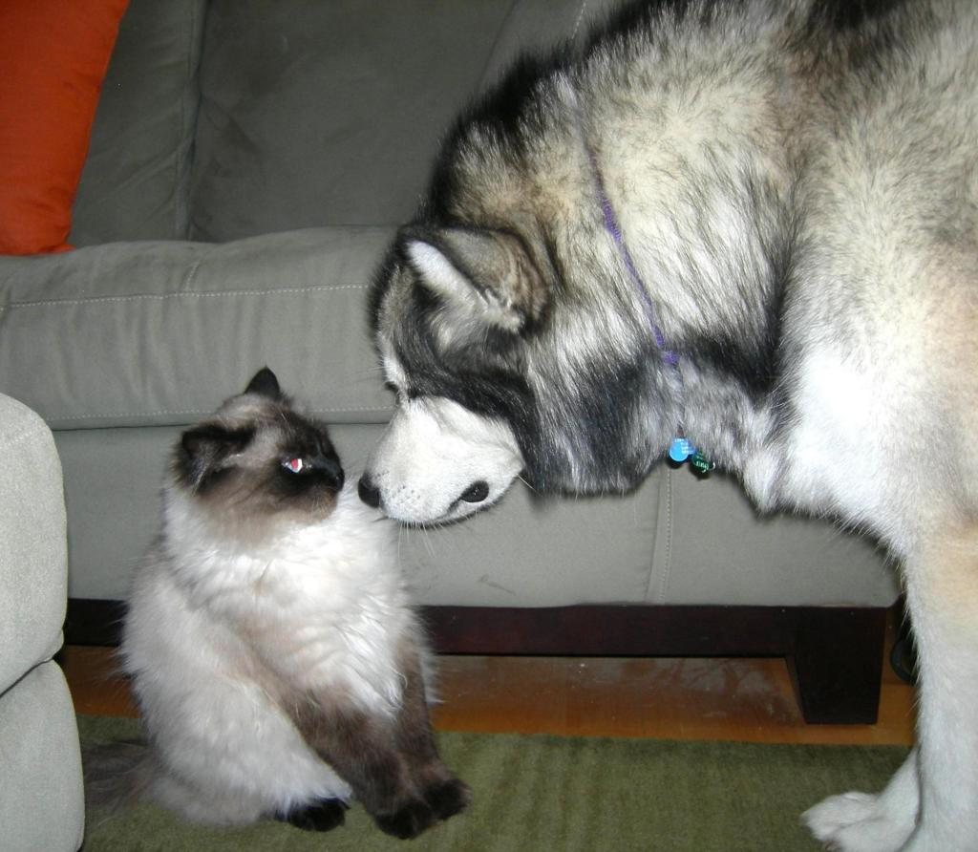
To put it another way . . .
There are a thousand ways to skin a cat!
Notes:
Just don’t ask the dog.

Slide 57
Evaluation and Practice Getting Dirty in the Trenches
Notes:
My advice: Get dirty by evaluating your writing and practicing with a purpose.

Slide 58
How to Evaluate Your Writing
Whether it’s a job transcript or practice, why is analysis important?
[open question]
Notes:
We learned in school to write a five-minute take and determine if that “felt good” before moving on to the next one.

Slide 59
How to Evaluate Your Writing
Why is analysis important?
You need to determine the strength of each of your “CRR Basics”:
Untranslates/mistranslates as a result of:
Inaccuracy (finger drills)
lack of speed (“listen” to faster speeds for an entire month before a rigorous three-month practice schedule)
hesitance in theory recollection (make your own audio drills from specific word lists, making them from a five-minute take that you can then practice to over and over as well is even better)
Conflicts or poorly resolved conflicts
Punctuation
You can’t write what you haven’t learned
You can’t write what you haven’t decided to implement as basic punctuation principles
Word-boundary issues
Prefixes and suffixes as well as compound words
Notes:
These are the basic categories reporters need to use when evaluating a five-minute practice take for realtime readiness.

Slide 60
How to Evaluate Your Writing
Why is analysis important?
You need to determine the strength of each of your “CRR advanced techniques”:
If you had all the time in the world, could you write ANY piece of material given to you?
Can you stitch acronyms? (Do not underestimate the power of this tip!)
Can you write:
hyphen with no space, hyphen with a space (marked-up document, 3- to $4,000
forced space, delete space, cap, uncap, colon with two spaces after, colon with no space after
( (^ ) “ “^ “
.0 0.0 .com, .org @ #
Can you stitch words that are spelled out in the record?
Can you fingerspell and stitch lowercase letters together? (If given all the time in the world?)
Can you utilize macros to write dollar amounts or fix something you’ve already written?
Do you paragraph appropriately and flag trouble areas that tran so you can clean them up without having to “edit” the transcript in order to do so?
Notes:
These are the basic categories reporters need to use when evaluating a five-minute practice take for realtime readiness.

Slide 61
How to Evaluate Your Writing
If you had all the time in the world to write ANY piece of material given to you, what would you start working on first to make that happen for you?
[Discuss]
Notes:
These are the basic categories reporters need to use when evaluating a five-minute practice take for realtime readiness.

Slide 62
Prefixes/Suffixes
First thing you need to do before you start messing with your dictionary is:
BACK IT UP!!!
Remember that anytime you make a copy of something and then alter the original, you no longer have a backup; you just have one copy of your original before you altered it. Store this backed-up dictionary in two different places.
[DO THIS NOW.]
Notes:
Backup: “The procedure for making extra copies of data in case the original is lost or damaged.”

Slide 63
Prefixes and Suffixes
Basic suffixes:
ing
s
d
y
ly
Do you have these in your dictionary by themselves as a “catch-all?”
List of basic prefixes and suffixes:
http://teacher.scholastic.com/reading/bestpractices/vocabulary/pdf/prefixes_suffixes.pdf
List of comprehensive suffixes:
https://www.learnthat.org/pages/view/suffix.html

Slide 64
Prefixes and Suffixes and how they affect compound words
Some words are used as both prefixes and suffixes:
Up upload, holdup
Down downside, facedown
Back backdrop, piggyback
Front frontside, forefront
In inbounds, -- (break-in)
Out outlook, takeout
Over overdressed, takeover
Under undercover, -- (over-under)

Slide 65
Prefixes and Suffixes and how they affect compound words
I can’t see the jet way over there.
For me:
Jetway JET/WOI
-or-
JET/DLOIT/WAI

Slide 66
Prefixes and Suffixes
Some words used as prefixes and suffixes are sometimes used connected to another word and sometimes need a hyphen
-back
-year
-day
-time
When you start working a prefix or suffix theory, consider how it will affect words across a broad spectrum.
Open your own dictionary and search for the prefix/suffix to get an idea what sorts of words you already have defined in your dictionary

Slide 67
Prefixes and Suffixes
Some prefixes and suffixes may cause you particular difficulty. You will need to determine which ones wreak the most havoc with your theory and maybe even with the way you have changed that theory and your dictionary over time.
Pay close attention to detail when entertaining the idea of changing the way you do those in your dictionary. No shotgun approaches! Comprehensive analysis and fixes for as many related issues as you can find/think to take care of is your best approach
For me:
EL, AL IN, EN

Slide 68
Prefixes and Suffixes
increasingly
meaningful
penniless
alight
Notes:
Some things you can do when you create prefixes and suffixes each as their own dictionary entry.

Slide 69
Prefixes and Suffixes
If you rework or add a prefix/suffix to your dictionary, consider how that new theory added to your dictionary affects the words that are already in there.
In other words, don’t create new problems by adding a “fix” in the form of a new prefix or suffix to your dictionary and not thinking through the consequences of the bigger picture.

Slide 70
Hyphen Cheaters
An out-of-the box idea
YOUT/-FT
-or-
OUT/-*FT
An out-of-mind experience
YOUF
-or-
OUT/-*F

Slide 71
Prefixes and Suffixes
houseboat housecleaners housework
housemate housewife household
roughhouse lighthouse warehouse
powerhouse packinghouse madhouse
Pricewaterhouse PricewaterhouseCoopers
Notes:
Spend some time sorting your dictionary so that you can consider “all” possibilities

Slide 72
Conflicts
Do you want conflicts?
[open question]

Slide 73
Conflicts
If you choose to purposely make conflicts rather than resolve conflicts, consider how your AI will affect these choices in the future if you have that feature turned on.
If you purposely make conflicts, “work them” when you are putting them in your dictionary so that your AI knows what to do with those conflicts in a wide variety of situations. (Literally, write as many sentences as you can think to construct using those words to help your AI learn ahead of time – on the “front end,” *not* on the job. http://sentencedict.com)

Slide 74
Families
Root words
review, reviews, reviewed, reviewing
reflect, reflects, reflected, reflecting, reflection
suspect, suspects, suspected, suspecting, suspicion
A good place to get these are from basic NCRA
RPR, CRR, CRC, RMR takes

Slide 75
Families
Phrase groups
keep in mind -- fair enough
in the meantime -- good luck
first of all -- that’s great
good
good morning fair
good afternoon fine
good evening
good faith
bad faith
good-faith
Can you think of more? [open question]
You can make a lot of progress and a lot of headway in your dictionary with some contemplative thinking and some global thinking -
Rather than trial-and-error or that gunshot approach!

Slide 76
Continuous Realtime Notebook Involvement
Are you working on that realtime notebook as we’re going along and contemplating what you want your categories and subcategories to look like?
Do you have some troubleshooting areas and some dictionary maintenance work you are going to want to do? Are you systematically writing it down in that notebook?

Slide 77
The Power of Practicing with Intent
New Briefs_1.pdf
Create Audio Drills
“Tami Takes”
Practice until written perfectly *and* with the new designated one-stroke briefs

Slide 78
The Power of Practicing the Same Material
Brain – neurons – connections firing
Shortcut through the woods
Keep taking it until your brain remembers the shortcut better than the long way
You can do this!! (No, you are not too old for your brain to relearn some things.)
Notes:
. . . but it does take a specific practice regimen being developed in order for it to be effective.

Slide 79
Evaluate what you write when you practice!
Look through your practice material
Old School: “How did that feel?”
You’re not transcribing from paper notes anymore, so don’t practice like you are.
EVALUATION IS THE KEY TO ADVANCEMENT
In addition to being able to work your theory and work your dictionary, you help connect the dots for your brain when you do this. Do not underestimate or forget the power of evaluation!

Slide 80
Creating a “writing style” that enables you to work a rough draft
Rough draft flags/scan stops
My basic flags/scan stops:
KHAUD **
SAUNS <*
PAUNS *[punct.]
KHAUPS *[ck sp.]
STPH-FPLT * general flag (e.g., mistran above,
something up there needs to be capped)

Slide 81
Creating a “writing style” that enables you to work a rough draft
Consider using some macros
Need to know how your software works
Need a method of writing them down
Need a method to practice them
Need a method to not forget them
[Open up Eclipse tag file]

Slide 82
Speaker IDs Throw-Away Job Briefs One-Stroke Blurbs - Comprehensive
WRITE THEM DOWN
PRACTICE THEM
MAKE AUDIO DRILLS
KEEP THEM IN SEPARATE JOB DIX?
How to make list, how to remember them?
[Questions, comments]

Slide 83
Editing for your Dictionary, not the Transcript
Retranning a job that’s already been finaled will help you better understand this concept (tran w/ job dix.)
What is still there that’s left that needs to be in your dictionary?
IF IT’S AT ALL POSSIBLE, WHEN YOU EDIT SOMETHING, MAKE SURE THAT YOU NEVER
HAVE TO TOUCH THAT ISSUE AGAIN!

Slide 84
Practice Making Roughs!
Figure out how to do this and then rough out every single job before you either finalize it or send it to a scopist.
This really is an efficient method.
I do it every single job even if they don’t request a rough.

Slide 85
Get the Gold
Get the gold before you fix the “junk” untranslates, before you touch up for that final transcript.

Slide 86
Get the Gold
Exceptions:
Paragraphing, quotes, caps for consistency
This will make your final transcript more accurate (can concentrate on the nitty-gritty, not the formatting details) and will certainly give it more polish.
Notes:
It is so much easier to find substantive errors on a proof in a “polished” transcript! Consistencing in the formatting helps greatly with that.

Slide 87
Patterns, Categories, Strategies
All of these “patterns” also make it easier to systematically scan through a transcript to make a rough draft.

Slide 88
7 Power Reporter Tips: (Listed down right side of page on every PowerReporter.org blog page)
#1 Continuous perfecting of your theory
#2 Continuous dictionary management
​
#3 Continuous perfecting of your writing style
​
#4 Continuous realtime practice and analysis
​
#5 Continuous speed practice and analysis
​
#6 Continuous education and continuous search for growth opportunities
​
#7 Network with reporters who are smarter than you are! :-)

Slide 89
The Power of the Buddy System
You may not feel like you have something to offer. I promise you, you do!
“Knowledgeable neighbors”
Effectiveness of “buddy brainstorming”
WRITE IDEAS IN YOUR NOTEBOOK to help create your path, one idea at a time
Evaluate notebook entries, come up with new ideas to advance you even further when the time is right

Slide 90
The Power of the Buddy System
Use a buddy to:
troubleshoot ideas
“work ideas”
to sit down and do dictionary maintenance
(perhaps over a cup of coffee?)

Slide 91
Part Art, Part Science
Theory
Writing Style
Editing Style
Punctuation and grammar rules and style
You are not stuck in a box
This process is so very individualized

Slide 92
Notes:
Consider asking your local firm or state association to host a Rough Draft Boot Camp. We’ll spend a day getting dirty in the trenches together!

Slide 93
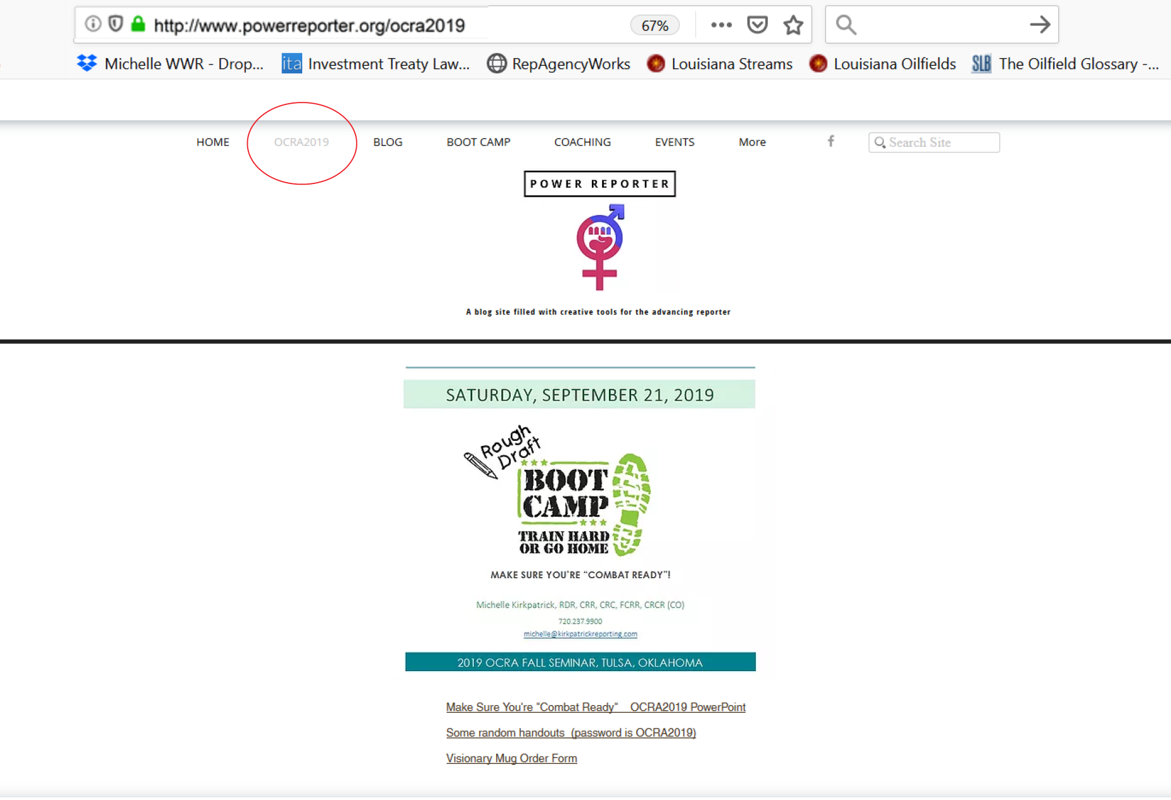
Notes:
PowerReporter.org, click on NCRA2018

Slide 94
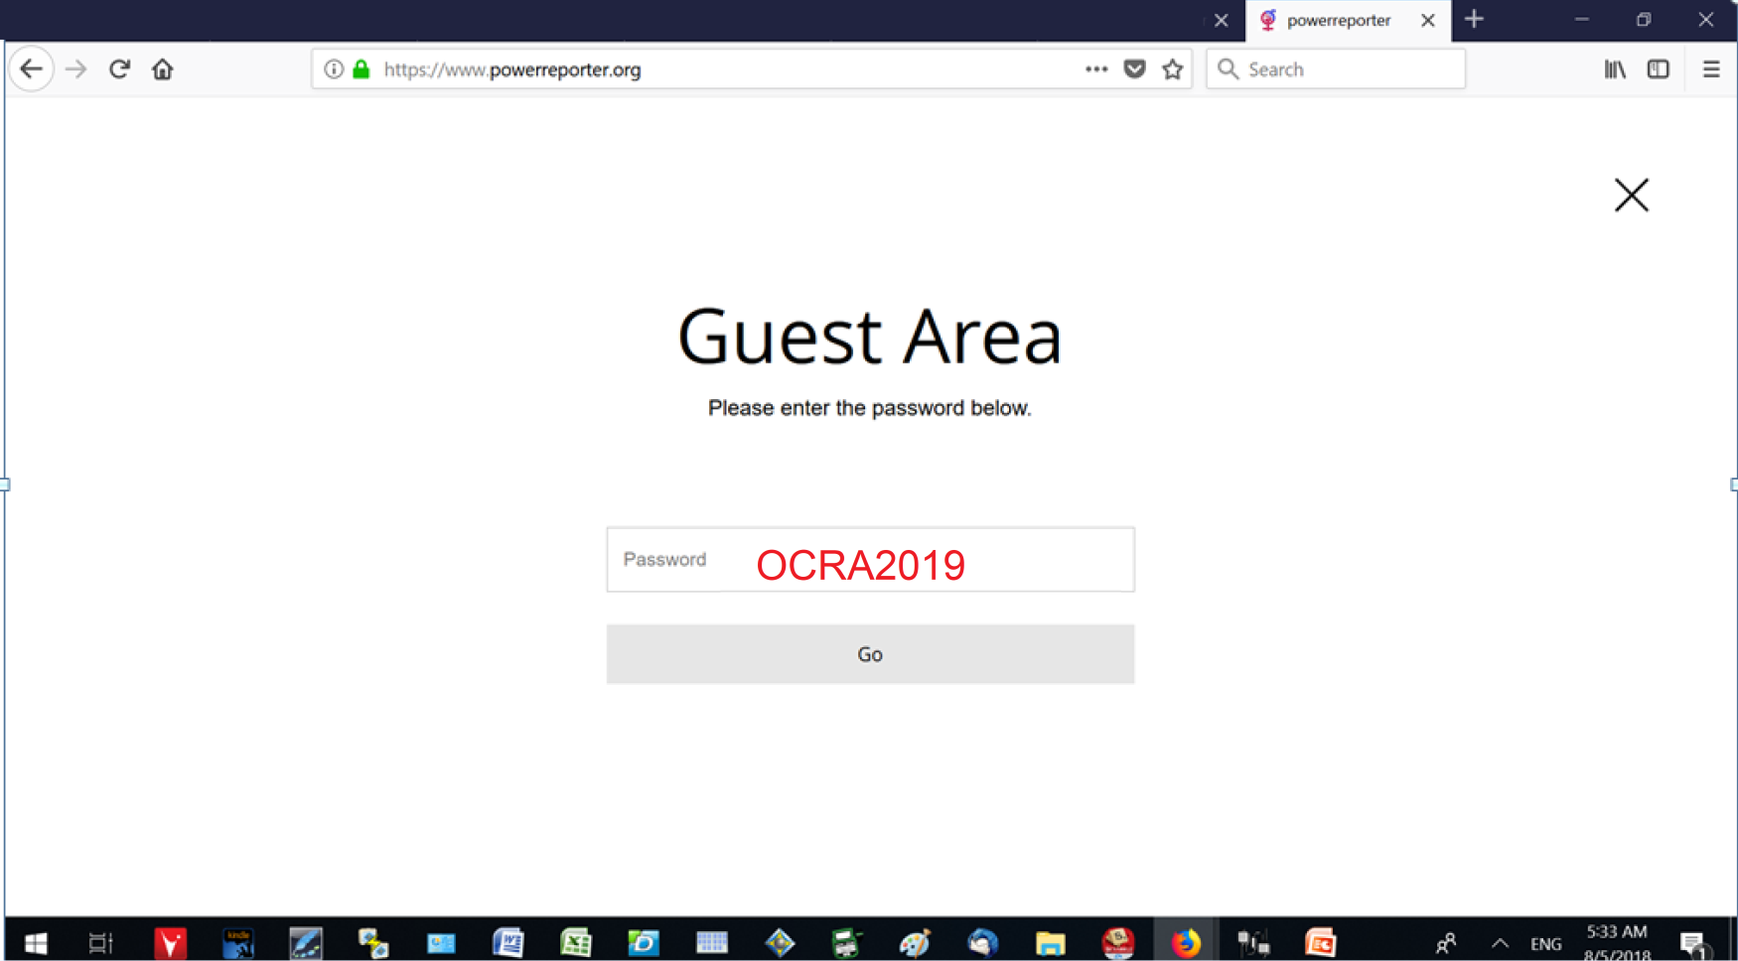
Notes:
PW: NCRA2018

